Slide 1
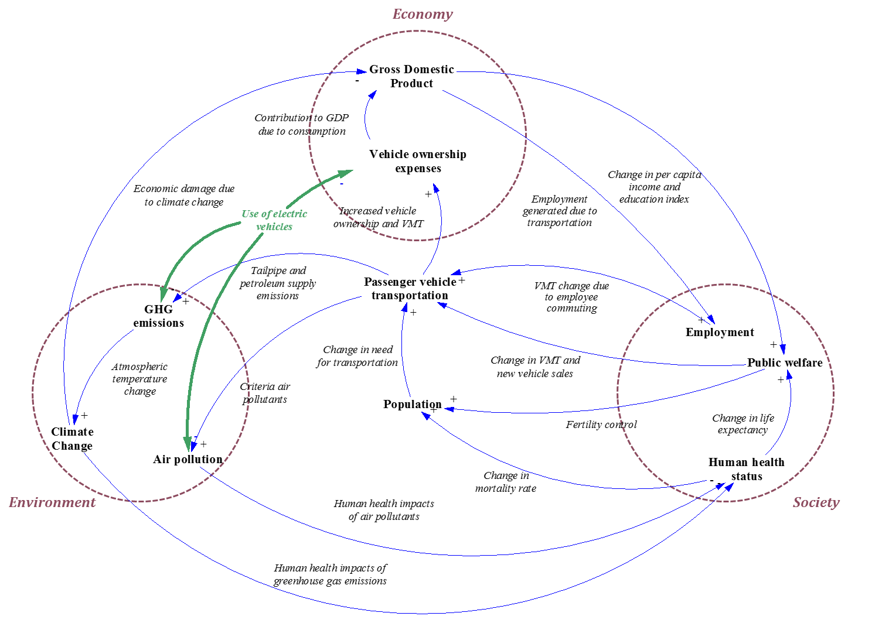
DYNAMIC LIFE CYCLE SUSTAINABILITY ASSESSMENT FRAMEWORK
FOR ELECTRIC VEHICLES IN THE U.S.
TRB 16-0685
Nuri Onat, Murat Kucukvar, Omer Tatari, and Gokhan Egilmez
Department of Civil, Environmental & Construction Engineering, University of Central Florida
Overview
Analyzing sustainability impacts of alternative vehicle technologies such as battery electric vehicles (BEVs), plug-in hybrid electric vehicles (PHEVs), and hybrid electric vehicles (HEVs) is an emerging topic in the transportation research. This research aims to present a novel approach to quantify macro-level social, economic, and environmental impacts of the alternative vehicle options. System dynamics modeling is used to capture complex dynamic relationships between economy, society, the environment, and the U.S. transportation. This study also aims advance the current understanding transportation sustainability and existing life cycle assessment methods by considering all of the inherent mutual relationships in the environmental, social, and economic aspects. A total of seven macro level impact categories are selected and the impacts are quantified from 1980 to 2050, which are global warming potential, particulate matter formation, photochemical oxidant formation, contribution to gross domestic product, vehicle ownership cost, human health impacts and employment generation, and. Extreme customer choice scenarios are tested for each vehicle type to compare their maximum potential impacts. BEVs are found to be a better alternative for most of sustainability impact categories in long run, while they are economically not preferable until mid-2020s. Analysis results revealed that any alternative vehicle option, alone, cannot reduce the rapidly increasing atmospheric temperature and the negative impacts of the global climate change, even though the entire fleet is replaced with the most environmental friendly vehicle option.
Results
Manufacturing impacts of S-EV and S-PHEV are much higher compared to other scenarios, which is mainly because of the battery manufacturing On the other hand, the CO₂ emissions are revered in the operation phase, in which the EVs are found to be the best option followed by the PHEVs. When total life cycle impacts are considered, the impacts of manufacturing phase is effective between 2016 and 2018. The total life cycle CO₂ emissions of EVs are found to be least after several years of worst performance due to manufacturing phase. Considering that the battery improvements and associated impacts are taken into account, the technological advances in battery technology favors EVs and PHEVs, while fuel efficiency improvements favors all of the vehicles at different degrees. BAU scenario, which contains much higher number of ICVs, has a declining trend than to fuel efficiency improvements of ICVs.
Manufacturing phases of PHEVs and EVs have the greatest contribution to employment. Manufacturing phases of all of the vehicle types have increasing trends as the size of the transportation sector grows with the increasing vehicle demand. On the other hand, only employment contribution of ICVs, defined under BAU scenario, has an increasing trend in operation phase, whereas rest of the vehicle types are either stable or decreasing due to transformation by the more technology oriented sectors and reduced consumption. The total life cycle employment trends have a fluctuating structure where newly introduced technologies creates more employment at the beginning and reaches an equilibrium afterwards. Overall, the total life cycle employment contribution of HEVs and ICVs are more stable and increases with almost a constant slope mainly due to increased travel demand and developments in the associated sectors.
Discussion and Conclusions
The impacts from feedbacks are found to be relatively smaller compared to effects of exogenous variables such as GDP growth of the entire economy, population growth, etc. Thus, sustainability impacts of products highly depend on its surrounding environment as it is clearly shown in this study. Therefore, when assessing triple bottom line impacts of any product, the system surrounding it should be taken into consideration. Among the tested scenarios, S-EV had the highest effect resulting from the feedback loops. It should be noted that the feedback impacts resulted from 9 reinforcing and 3 balancing loops, indicating a reverse impact and cancel one another depending on their impact scale. This behavior can be different in other systems, which might result in much greater feedback impacts if one of the loops dominates the others (reinforcing or balancing). Hence, when assessing life cycle sustainability impacts of products, these feedback relationships should be taken into consideration.
Analysis results revealed that vehicle choice effect the public welfare at small scale. Exogenous determinants of public welfare, life expectancy, income, and education overwhelm the effects of vehicle choice. Considering that public welfare is one of the major indicators that society cares about, small changes in that may cause significant changes in society and may greatly affect the overall behavior of the system. Therefore, assessing sustainability impacts of products, systems, or processes should overarch set of social indicators and give insights about possible changes may be resulting from it.
There is a strong need for robust simulation models that would allow us to consider dynamic complexity to mainly understand, not just predict, possible future scenarios
Figure 1.
Analysis covers the TBL impacts related to manufacturing and operation phases of internal combustion vehicles (ICVs), hybrid electric vehicles (HEVs), plug-in hybrid electric vehicles (PHEVs), and battery electric vehicles (BEVs). The useful life time is assumed to be 150,000 miles per vehicle.
A total of seven macro level impact categories are selected and the impacts are quantified from 1980 to 2050. The proposed SD model is composed of four comprehensive sub-models: environmental, economic, social, and transportation sub-models, which contains smaller modules such as population, travel need and on-road fuel efficiency, CO₂ emissions and climate change, particulate matter formation (PMF), photochemical oxidant formation (POF), vehicle ownership cost, human health, public welfare, employment, etc. Fig. 1 shows the causal loop diagram of the model, which shows the causal relationships among the sub-models and among smaller modules as applicable. The causal loop diagram (CLD) is a highly aggregated representation of the system serving to simplify, and thus more effectively explain, the major relationships among the sub-systems.
Methodology
In this paper, system dynamics modeling is utilized to model the U.S. passenger transportation system and its interactions with economy, the environment, and society. The proposed model aims to quantify the macro-level social, economic, and environmental (Triple-bottom-line, TBL) impacts of passenger vehicles from an integrated system analysis perspective.
Acknowledgments
This work was supported in part by an award to the University of Central Florida, as part of grant number DTRT13-G-UTC51 from the US Department of Transportation’s University Transportation Centers Program.
Figure 2. CO₂ emissions, a) Manufacturing Phase, b) Operation Phase,
c) Total Life Cycle
Figure 3. Contribution to employment a) Manufacturing Phase, b) Operation Phase,
c) Total Life Cycle

